Slide 1

P.R.E.P Introduction
“Where should I go on my next vacation?”
Ummmmm….
I don’t know.
Maybe...Greece.
“Have you ever been asked to give your opinion or asked a question about something?
But do you ever feel like you don't know what to say?
Or maybe you are talking too much or too little?
P.R.E.P. is an easy way to help you answer any question, give your opinion on any topic or even give an impromptu speech.”
Watch the intro video on P.R.E.P. to see how it works.
Source: “How to Answer Questions: The P.R.E.P. Method”, Virtual Speech Coach, https://youtu.be/FcJtMZ-gcm0

Slide 2
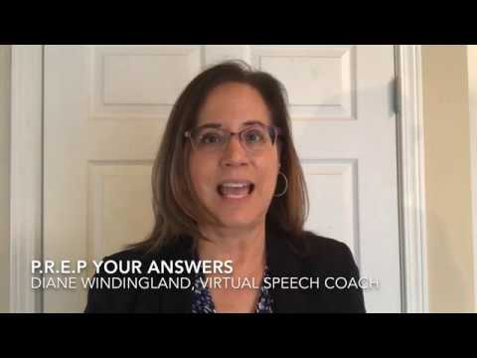
P.R.E.P Introduction
Watch the video to see P.R.E.P in action
Source: https://www.youtube.com/watch?v=FcJtMZ-gcm0&t=1s

Slide 3

P.R.E.P Introduction
P: Point/ Position
Give your opinion or answer a question by first stating your main point.
Talk about one point so you are focused.
Have a 2nd point?
Repeat the whole PREP process.
I think/ I feel
In my opinion,
In my point of view,
To begin with,
R: Reason
Give a clear, strong, specific reason to support your opinion.
The reason I say that is…
I think that because…
E: Evidence/ Example
Provide evidence that supports your reason.
Give an example, expert knowledge from something you have read, common sense or a statistic that you have read about.
For example,
To illustrate,
According to Statistics Canada...
Everyone knows that…
P: Restate your Point/Position
Conclude your answer, opinion or speech by restating your main point so that the person or people listening can remember what you said.
So,
Overall,
All in all,
To wrap up,
Image by Sasin Tipchai from Pixabay

Slide 4

P.R.E.P Example
Question: Where should I go on my next vacation?
P (position/point): I think you should consider going on a cruise for your next vacation.
R (reason): There are many reasons why cruises are great. The biggest reason for me is convenience.
E (evidence): For example, my husband and I went on a 22-day, 18-port cruise this fall. It was so convenient to have the ship take us from port to port as we only had to carry and unpack our bags once.
P (restate position): So, if you want to see a lot of places without a lot of stress, you should think about cruising.
Remember:
(P + R + E + P = ▽)
you can also review P.R.E.P and another example on this Google Doc
Image by dayamay from Pixabay

Slide 5
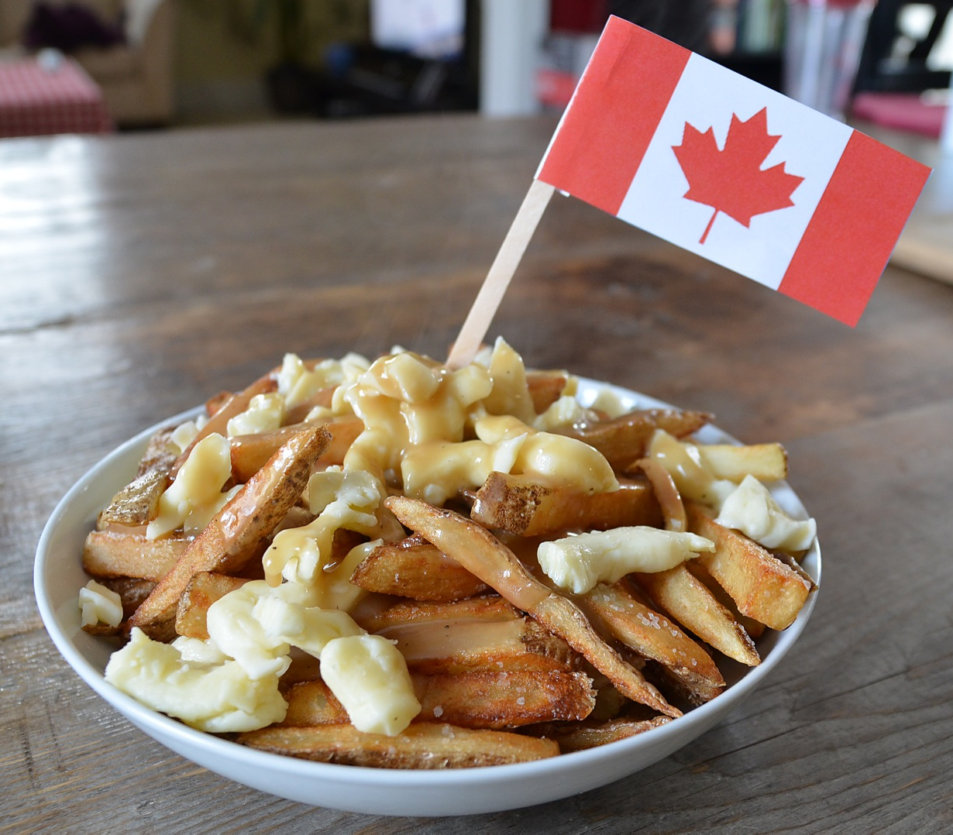
Practice Convo - P.R.E.P.
Yuka: Hi Mario, so, I have a question for you. What is the best traditional food from your country that people should try?
Mario: Well Yuka, one of the most popular kinds of food to try in Canada is poutine. (always repeat Q) It originally came from Quebec, but now you can get it anywhere. It’s french fries, gravy and a special kind of cheese called cheese curds. (P)
Yuka: mmmmm, sounds delicious!
Mario: Totally! Even though poutine isn’t healthy at all, I think everyone should try it at least once. The combo of fries, gravy and cheese is so tasty, and it’s a perfect dish to eat after going to a nightclub or if you’re at a pub with friends. (R) Actually, I just had it last week when I went to Niagara Falls. I figured that since I was going to such a touristy city, I should have a traditional Canadian dish. It was so yummy! (E) So, for sure, if you’re in Canada, you gotta try poutine! (P)
Yuka: Wow, your description makes me want to try it! Maybe even today! Wanna come with me?
Mario: Ya! Let’s go to New York Fries; their original poutine is the best! So, Yuka, what’s a traditional food from Japan that I should try?

Slide 6

Your Turn
Image by Free-Photos from Pixabay
Use the strategies you have learned for expressing your opinion and active listening to discuss the following question:
Q: What is the best traditional food from your country that people should try?

